Slide 1
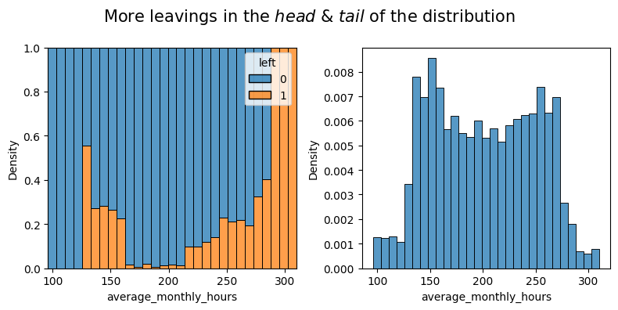
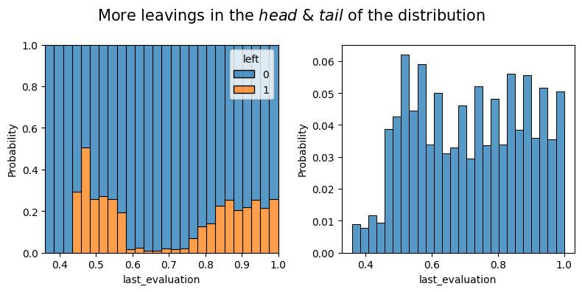
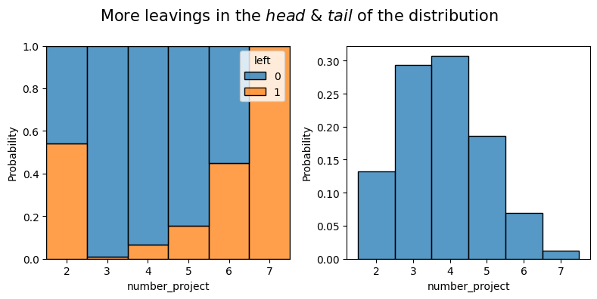
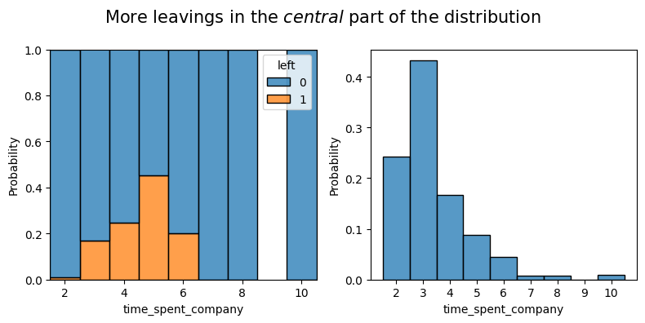
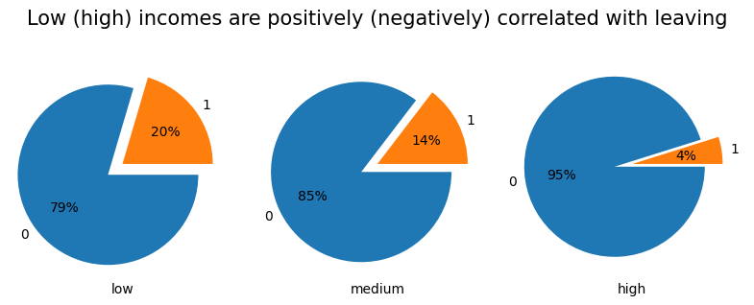
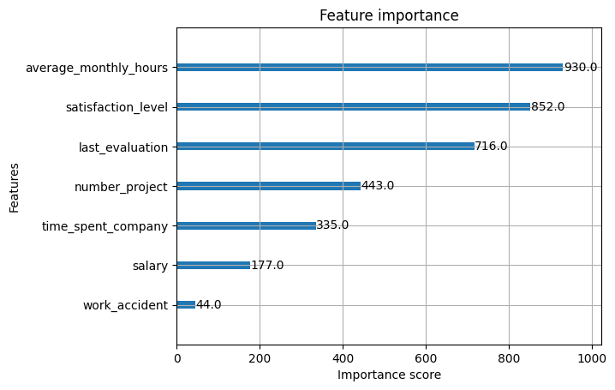
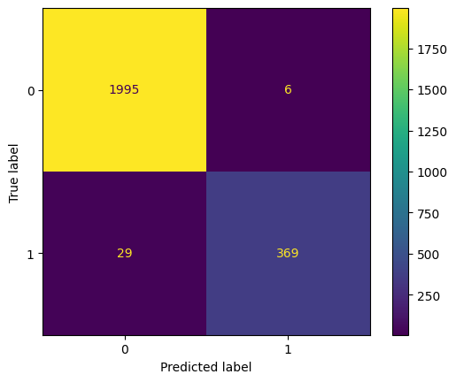
Google Advanced Data Analytics Capstone
Salifort Motors
Executive summary: Employee Leaving Model
Currently, there is a high rate of turnover among Salifort employees. the high turnover rate is costly in the financial sense.
Salifort’s senior leadership team has asked the data team to build a model to predict employee leavings, and to come up with ideas for how to increase employee retention
The data team as performed exploratory data analysis on the dataset at hand.
Initial insights were made by analyzing visual patterns.
A champion XGBoost model was selected which predicted leaving with high score.
A reshuffling in train-test data is suggested to make sure the model is not overfitted to current data.
Making decisions to regulate the most important features to minimize leaving, e.g.:
policing average_monthly_hours
regulating number_projects
motivating packages for employees between 3 to 5 years of presence in the company.
motivating packages for well-performed employees.
top important features:
`department` has no significant effect on leaving.
The main score of interest was `recall`, with 93% score; only 7% of actual leaving employees are mispredicted as retaining.
`satisfaction_level` must be examined in more details, as it certainly contains fundamental criteria for leaving or retention.

